Slide 1
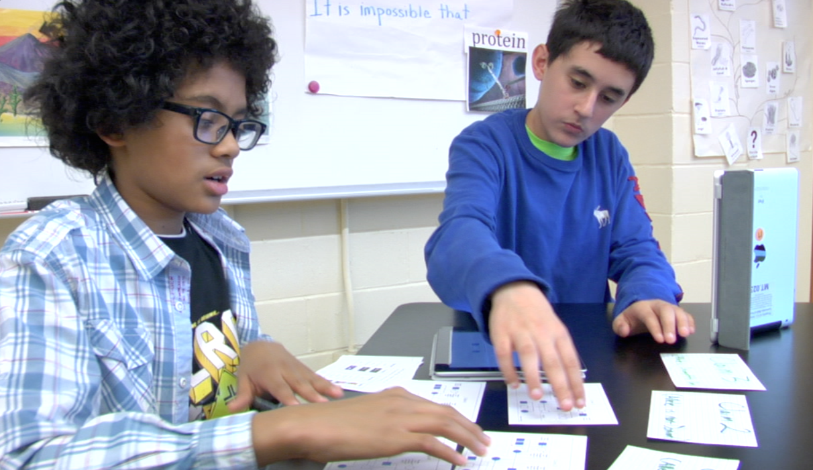
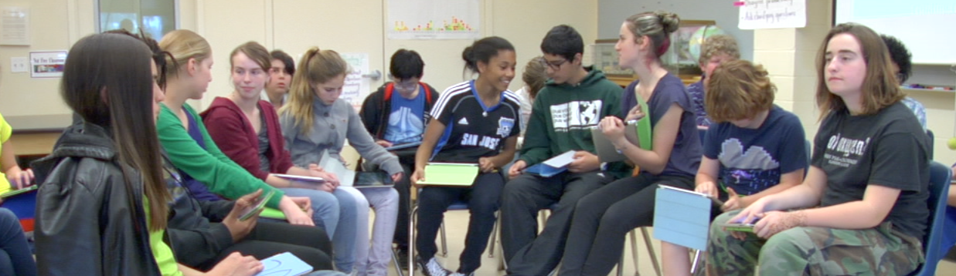
Multimedia Tools for Supporting K–8 Instruction in the NGSS Science Practices
Kevin Cherbow & Katherine L. McNeill
Boston College

Slide 2
Agenda
Introductions
Presentation 3 groups of practices
Introduce Continuum
Use Continuum to Analyze Video
Lesson Adaptation Activity
Other Tools and Resources
PowerPoint and Handouts at- https://www.sciencepracticesleadership.com/about.html

Slide 3
Introductions
Participant Backgrounds
Elementary school teachers?
Middle school teachers?
High school teachers?
Science coordinator/administrators?
Curriculum developers?
University faculty members?
Other?
Notes:
Ask participants to raise their hands for the different categories to see who is in the room

Slide 4
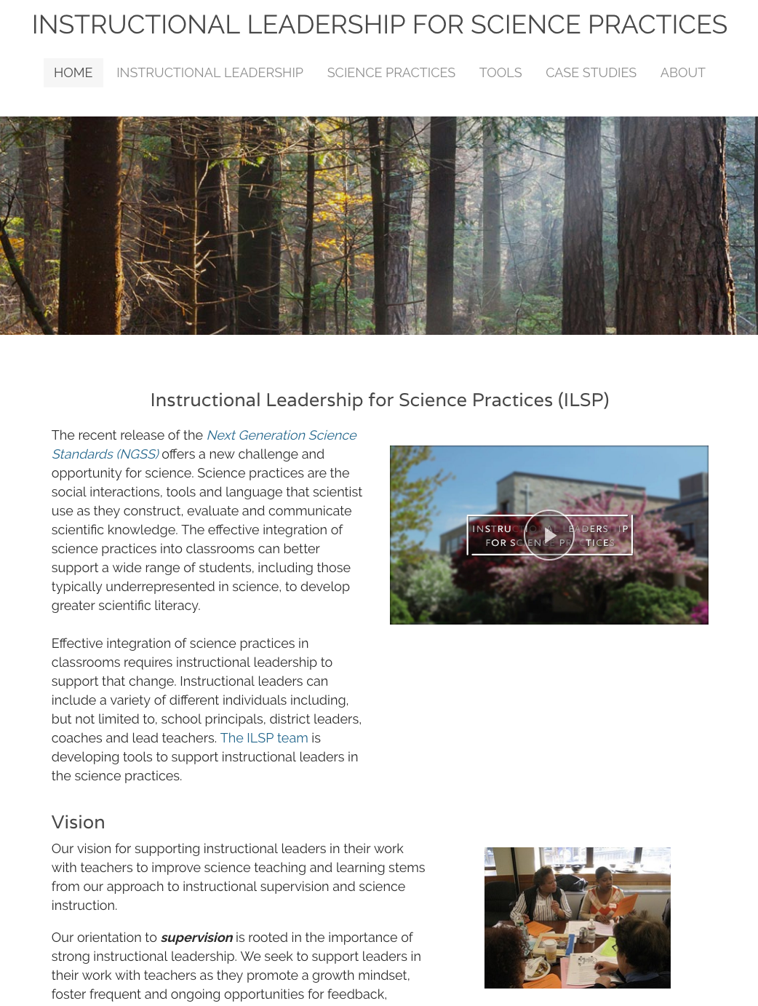
ILSP Project
Website - http://www.sciencepracticesleadership.com/

Slide 5
Science Practices: A shift in science education
Historically, science education has overemphasized students learning a myriad of facts rather than understanding how ideas are developed and transform over time (Roth & Garnier, 2006).
“Science is not just a body of knowledge that reflects current understanding of the world; it is also a set of practices used to establish, extend, and refine that knowledge. Both elements – knowledge and practice – are essential” (NRC, 2012, p. 26).
Notes:
With reading it’s always comprehension, fluency, phonics, that doesn’t change. With science, the units of study do change.” Principal 12

Slide 6
Grouping the Practices (McNeill et al., 2015)

Slide 7
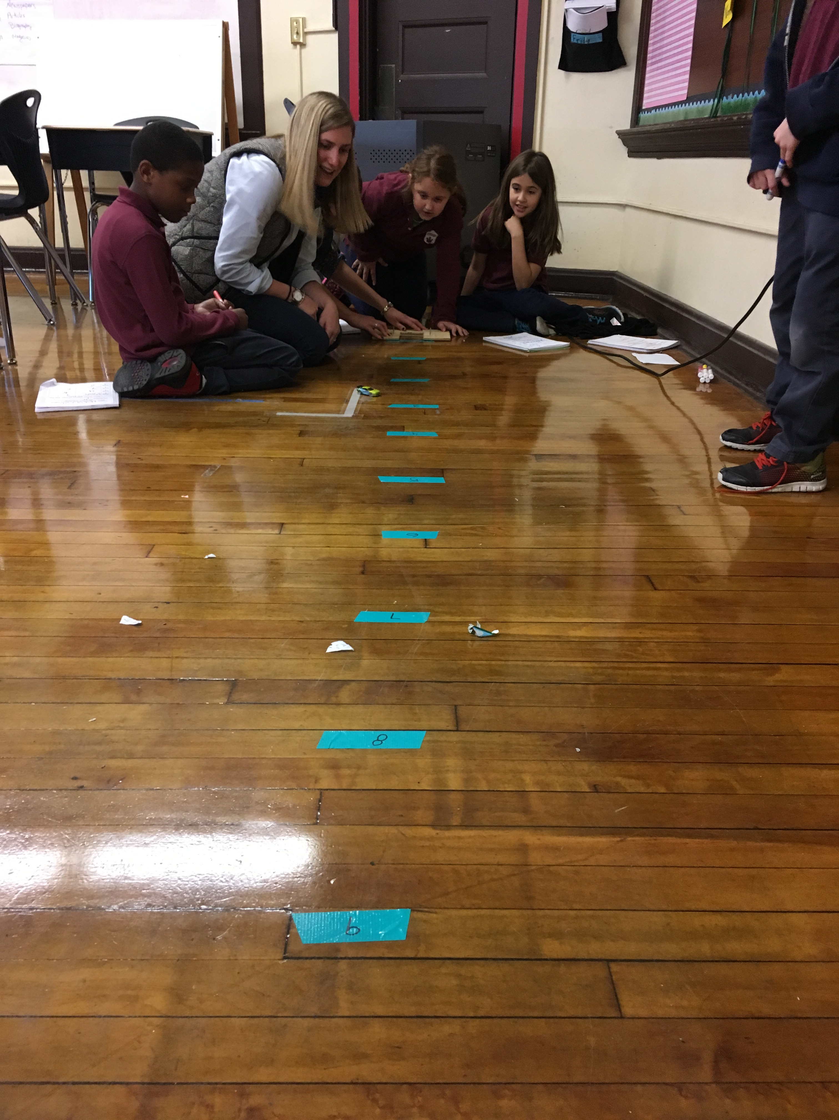
Investigating Practices
Investigating practices focus on asking questions and investigating the natural world.
The products of these investigations are data.
This includes 3 science practices
Asking questions
Planning and carrying out investigations
Using mathematical and computational thinking

Slide 8
Sensemaking Practices
The Sensemaking Practices focus on making sense of that data by looking for patterns and relations to develop explanations and models.
This includes 3 science practices
Analyzing and interpreting data
Constructing explanations
Developing and using models

Slide 9
Critiquing Practices
The Critiquing Practices emphasize that students need to compare, contrast and evaluate competing explanations and models as they make sense of the world around them.
Critique is a hallmark of the practices of scientists, but is frequently absent from k-12 science instruction (Osborne, 2012).
This includes 2 science practices:
Engaging in argument from evidence
Obtaining, evaluating and communicating information.

Slide 10
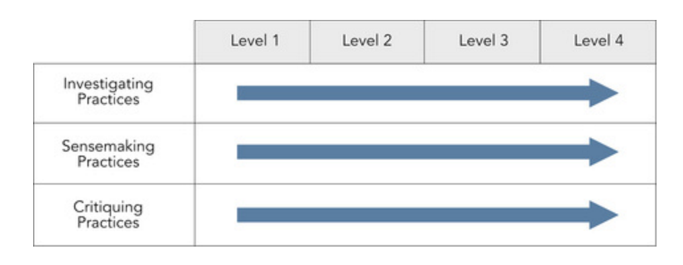
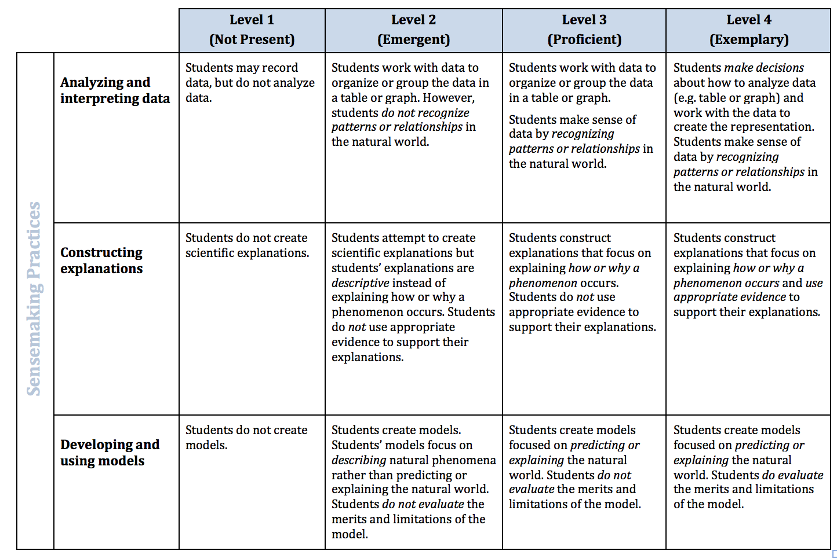
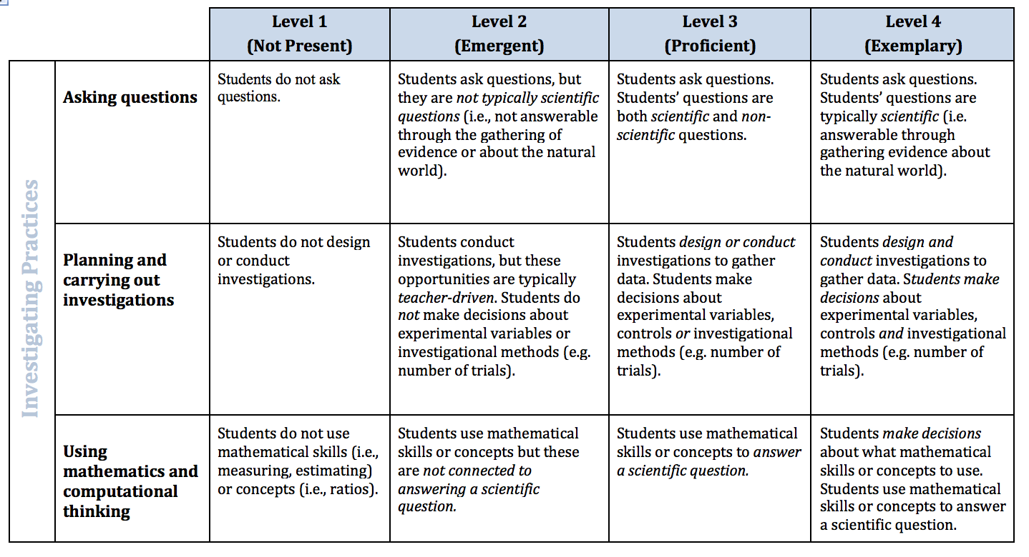
Science Practices Continuum (McNeill et al., 2015)

Slide 11
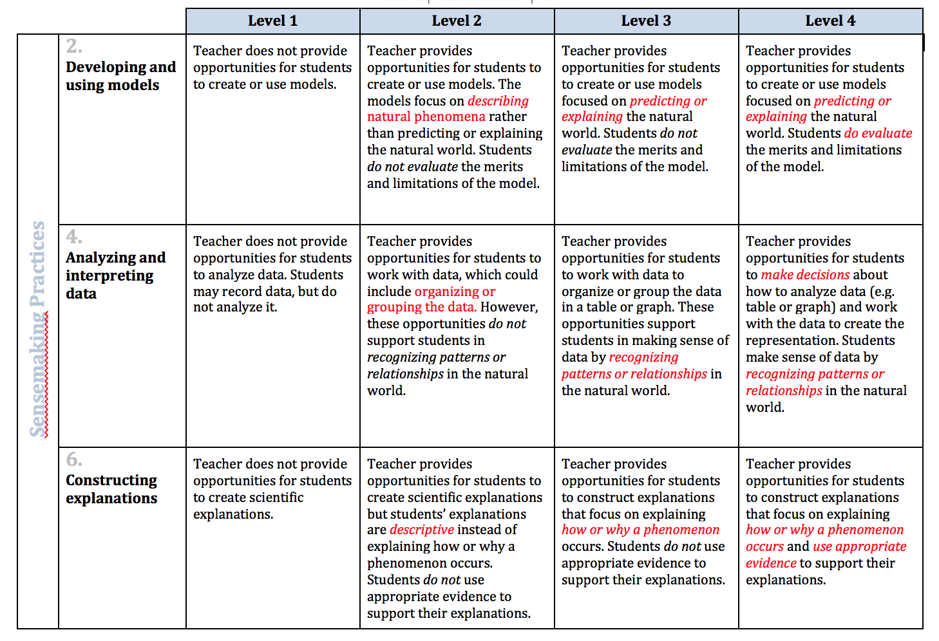
Continuum – Sensemaking
Notes:
For each of the 3 sensemaking practices, I would highlight the key levers in that practice.

Slide 12
Analyze Video
We are going to watch a video clip from a 4th grade science lesson (0:00 – 5:00)
Analyze it on the Continuum for the 3 “Sensemaking” science practices
Analyzing and interpreting data
Constructing explanations
Developing and using models

Slide 13
3rd Grade Physical Science Video
With a partner:
Discuss which science practices you observed.
Discuss where and why you placed each practice on the Continuum– Level 1, 2, 3 or 4.
Whole group share out

Slide 14
Lesson Adaptation Activity
2nd grade-Life Science
2-LS2-2. Develop a simple model that mimics the function of an animal in dispersing seeds or pollinating plants.*
Read through each of the lesson adaptation (A-D)
With your table mates, discuss and order the four adaptations along the Science Practice Continuum (Levels 1-4) for the Developing and Using Models practice.

Slide 15
Lesson Adaptation Activity: Discussion Questions
 | Level 1 | Level 2 | Level 3 | Level 4
Vignette
A
D
B
C
Why did you place the adaptations along the continuum in that particular order?
What were the key levers which distinguished one adaptation’s level from another?
In general, which adaptation(s) felt the most similar to the type of science instruction in your school? Why?

Slide 16
Other Tools and Resources

Slide 17
Other Tools and Resources

Slide 18
Other Tools and Resources

Slide 19
Other Tools and Resources

Slide 20
Other Tools and Resources

Slide 21
Other Tools and Resources

Slide 22
Contact Information
Kate’s e-mail – kmcneill@bc.edu
Kevin’s e-mail – cherbow@bc.edu
ILSP Website- https://www.sciencepracticesleadership.com/
Kate’s website- http://www.katherinelmcneill.com
Thanks to -
National Science Foundation - Instructional leadership for scientific practices: Resources for principals in evaluating and supporting teachers’ science instruction, DRL-1415541.
Colleagues at the ILSP Project- Rebecca Lowenhaupt, Benjamin R. Lowell, & Megan T. McKinley

